Slide 1
WGPD Webinar
Brazilian public debt overview: trends, management strategies and audit mandate
Bruno Martinello Lima (Secretário de Controle Externo)
João Ricardo Pereira (Auditor-Chefe)
Joaquim Ramalho de Albuquerque (Diretor)

Slide 2
Federal Court of Accounts Mandate:
Federal Constitution: art. 70 a 74; art. 163, clauses VIII and IX -> Public Finance matters;
Complementary law n° 101/2000: Fiscal responsibility law -> Debt indicator and trajectory;
Complementary law n° 200/2023: Fiscal framework law. The Union’s fiscal policy must ensure the sustainability of public debt, preventing risks and promoting fiscal adjustments in case of deviations, in order to guarantee the solvency of public accounts. Adjustment measures include achieving fiscal results compatible with debt sustainability, limiting the growth of expenditures, applying constitutional restrictions, and improving revenue management.
The Budget Guidelines Law (LDO) will define fiscal policy guidelines and annual primary result targets for the current fiscal year and the following three years, aligned with a sustainable debt trajectory. Debt sustainability is considered achieved when targets are set to stabilize the ratio between the General Government Gross Debt (GGGD) and the Gross Domestic Product (GDP), as outlined in the Fiscal Targets Annex of the Fiscal Responsibility Law;
Law nº 8443/92: description of the art. 71;
Resolution TCU nº 322/2020: Sets forth rules and procedures for the ongoing oversight of public debt management by the Federal Court of Accounts (Tribunal de Contas da União — TCU).

Slide 3
Brazil Public Sector Debt Sustainability Analysis (DSA) - Baseline Scenario
(in percent of GDP unless otherwise indicated)
Debt, Economic and Market Indicators
 |  |  |  |  |  |  | Actual |  |  |  |  |  | Projections |  |  |  |  |  |  | As of 30/dec/2024 | As of 12/30/2024 |  |  | 2024
 |  |  |  |  |  |  | 2014-2022 |  |  | 2023 | 2024 |  | 2025 | 2026 | 2027 | 2028 | 2029 | 2030 |  | Sovereign Spreads | Sovereign Spreads
 | General gross public debt |  |  |  |  |  |  | 72,3 |  | 73,8 | 76,5 |  | 78,3 | 81,7 | 83,8 | 86,1 | 88,3 | 90,0 |  | Bond Spread (bp) 3/ | Bond Spread (bp) |  |  | 246
 | Public gross financing needs |  |  |  |  |  |  | 21,5 |  | 24,6 | 21,6 |  | 26,8 | 29,7 | 24,5 | 25,1 | 20,6 | 21,8 |  | 5Y CDS (bp) | 5Y CDS (bp) |  |  | 175.72
 | Real GDP growth (in percent) |  |  |  |  |  |  | 0,3 |  | 3,2 | 3,4 |  | 2,5 | 2,6 | 2,6 | 2,6 | 2,6 | 2,7 |  | Ratings | Ratings |  | Foreign | Local
 | Inflation (GDP deflator, in percent) |  |  |  |  |  |  | 7,1 |  | 5,2 | 3,8 |  | 3,8 | 4,2 | 4,4 | 4,4 | 4,2 | 4,0 |  | Moody's | Moody's |  | Baa1 | Baa1
 | Nominal GDP growth (in percent) |  |  |  |  |  |  | 7,4 |  | 8,6 | 7,3 |  | 6,4 | 6,9 | 7,2 | 7,1 | 6,9 | 6,8 |  | S&Ps | S&Ps |  | BB | BB
 | Effective interest rate (in percent) |  |  |  |  |  |  | 9,9 |  | 11,3 | 10,9 |  | 10,3 | 11,3 | 11,2 | 11,3 | 11,1 | 10,6 |  | Fitch | Fitch |  | BB | BB
Source: TCU, 2024

Slide 4
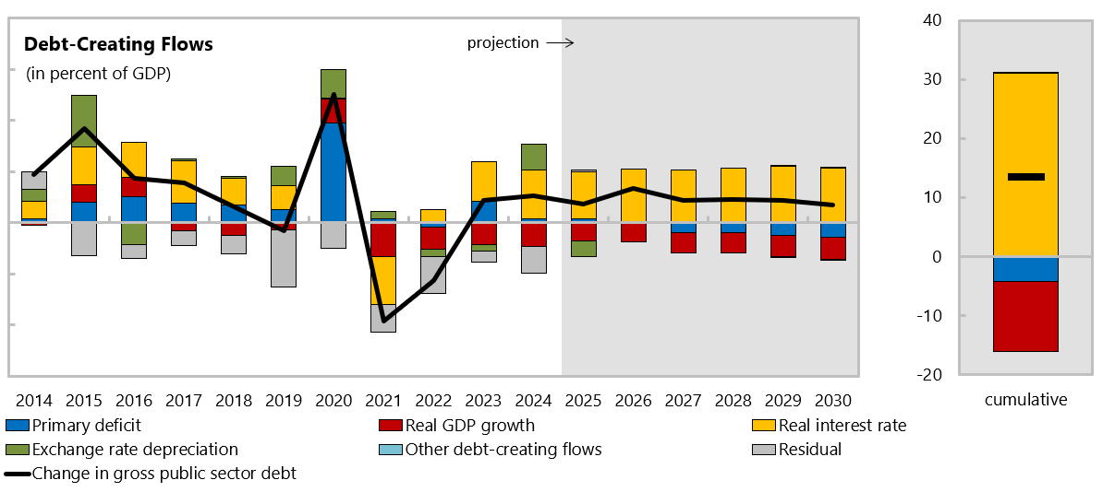
Source: TCU, 2024

Slide 5
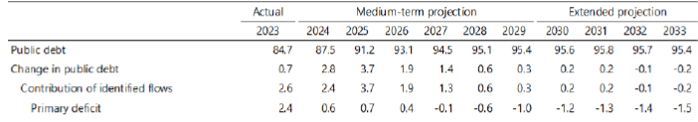
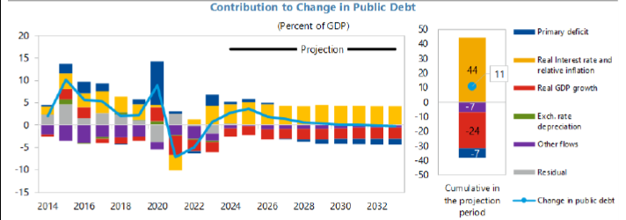
O Figure 4. Brazil: Baseline Scenario
(Percent of GDP unless indicated otherwise)
Source: IMF, 2024

Slide 6
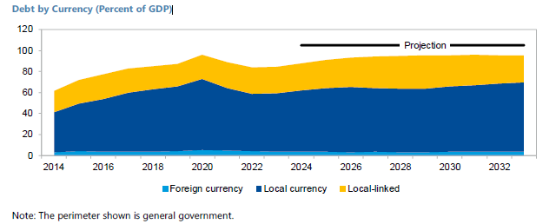
Brazil Public Debt Indicators
Source: IMF, 2024

Slide 7
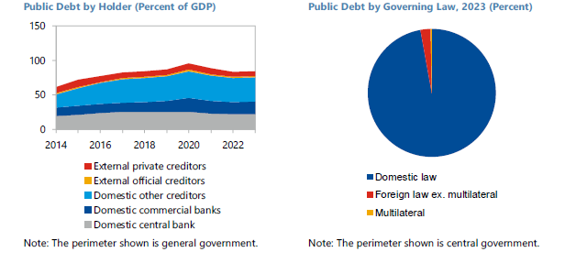
Brazil Public Debt Indicators
Source: IMF, 2024

Slide 8
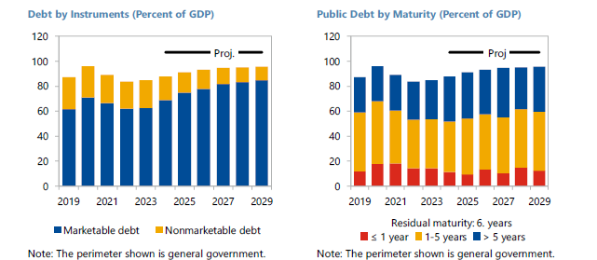
Brazil Public Debt Indicators
Source: IMF, 2024

Slide 9
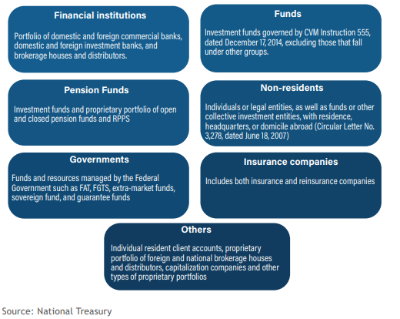
Debt strategies developed and implemented by the DMO to reduce debt at sustainable levels:
Expansion and diversification of the investor base;
Fiscal consolidation;
Liquidity reserve of R$ 860.1 billion;
Revenue of R$ 259.8 billion from other budget resources;
Retail programs: Treasury Direct, Renda+, Educa;
Law 13.820/19; Art. 5 — Subject to prior authorization from the National Monetary Council, the resources held in the results reserve referred to in Art. 3, observing the limit established in §2 of Art. 4 of this Law, may be used for the payment of the Federal Domestic Public Debt (DPMFi) when severe liquidity constraints significantly affect its refinancing.

Slide 10
Thanks!
E-mail: joaquimra@tcu.gov.br

