Slide 1
WGPD Webinar Block2
Auditing Public Debt Sustainability: key findings, recommendations, and impacts
Bruno Martinello Lima (Secretário de Controle Externo)
João Ricardo Pereira (Auditor-Chefe)
Joaquim Ramalho de Albuquerque (Diretor)

Slide 2
Auditing Public Debt Sustainability: key findings, recommendations, and impacts
Areas audited:
  Audit of Internal Controls and Public Debt Risk Management: to assess risk management framework, public securities auction process and payment process;
  Public Debt Sustainability: to assess the sustainability of the General Government Gross Debt (GGGD) and the compliance with the 2024 Annual Financing Plan (PAF), focusing on the main drivers of indebtedness, the management of the Federal Public Debt (FPD), debt projections, fiscal exposures (court-ordered debt payments, guarantees, and social security), and the federal government's financing needs.
  Primary auctions of government securities: to assess transparency, compliance with the rules and market concentration.
  Public Debt Fiscal Statistics: to assess the adequacy of public debt statistics in accordance with international standards.

Slide 3
Audit of Internal Controls and Public Debt Risk Management
Overview
Scope
The following processes were selected:
Definition and Monitoring of the Risk Management Framework
Traditional Auction Process and Government Securities
Payment Process of Matured Securities
Organizational Risk Management is a relevant process to ensure the achievement of the entity´s objectives.
Objective
Criteria
The audit aimed to assess:
  Risk Management
  Operational Controls
  Of Relevant Public Debt Operations
ISO 31000:2009
IN CGU 01/2016
Publications COSO
Regulations and Manuals of the DMO

Slide 4



Key Findings
Absence of a Risk Treatment Plan
Preparation and implementation of a risk treatment plan with detailed information
Only a timeline and a designated responsible party are defined.
Risk Management Manual
Result Reporting with Limited Scope
Results reporting should communicate risk management outcomes across the organization
In practice, results reporting remains limited to the managing unit's repository.
Risk Management Manual
Unmapped Existing Controls
Existing controls should be documented and considered in risk assessment
Some controls already in place were not mapped.
Risk Management Manual
Conflicting Information in the Tools Used
Interdependent tools are expected for identifying, assessing, and communicating risks
Tools show inconsistent risk levels.
Risk Management Manual
Insufficient Information Security Procedures
Implementation of treatment for high risks is expected
Information security control procedures are insufficient to meet the requirements of Decree 7.845/2012..
Risk Management Manual

Slide 5
Sustainability Audit of Public Debt
Overview
Scope
To assess the sustainability of the GGGD and compliance with the 2024 Annual Financing Plan, focusing on the main drivers of indebtedness, the management of the Federal Public Debt, debt projections, fiscal exposures (court-ordered payments, guarantees, and social security), and the federal government's financing needs.
The following coverage were selected:
General Government Gross Debt
Federal Public Debt
Federal Government Fiscal Exposure
Objective
Assessment
📌 Submit audit findings to the National Congress,
in the context of the review of the President of the Republic’s accounts.
✅ Objective: To provide technical input on fiscal sustainability, supporting informed decision-making.
Sustainability risk classified as moderate:
Based on the DSA model, the fiscal risk is considered moderate due to the high share of domestic investors (89.8%), low foreign exchange exposure (13.4% of the GGGD), and existence of a liquidity reserve sufficient to cover 6.24 months of FPD maturities.

Slide 6
Primary auctions of government securities: market concentrations
1. Compliance
✅ Applicable rules were followed.
⚠️ Limitations in accessing confidential data hindered a complete assessment of dealers.
🔍 Greater transparency in the processes is needed.
2. Transparency
❌ Public data showed inconsistencies and limitations:
  Regulatory errors in ordinances.
  Failures in APIs and results files.
  Absence of dealer performance history.
👉 Need for open and machine-processable formats (Access to Information Law) .
3. Competitiveness
⚠️ Concentrated primary market(LTNs e NTN-Fs).
🚫 Absence of formal metrics to assess competitiveness.
👉 Recommendation: introduce regular evaluations and formal criteria.
4. Positive initiatives by the DMO (STN)
✅ Confidentiality and anonymity of bids.
✅ Flexibility to adjust conditions to the market.
General Conclusion
🔗 Rules observed, but challenges remain in transparency and competitiveness.
🎯 Recommendations aim to strengthen governance, efficiency, and trust in the market.

Slide 7
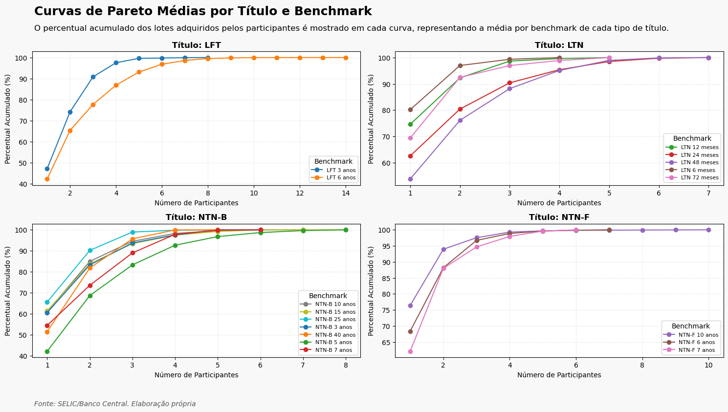
Primary auctions of government securities: market concentrations
The dynamics of the auctions are marked by strong concentration, with a few institutions dominating the trades, which highlights the need for metrics to monitor and promote greater competitiveness.
High concentration: a few participants dominate most of the acquisitions.
Pareto Curves: Confirm that a small group of dealers is responsible for the majority of the operations.

Slide 8
Public Debt Fiscal Statistics: potential risks
Institutional Units
1. Inadequate Classification of the Central Bank under the Central Government.
2. Improper Exclusion of Petrobras from the Non-Financial Public Sector
Are the existing institutional units
adequately presented in the
fiscal statistics?
3 Inadequate Classification of Non-Market-Oriented State-Owned Enterprises for the purposes of calculating Gross and Net Debt
4. Inadequate Classification of Telebrás under the Central Government for the purposes of calculating nominal and primary results
Debt Assets and Liabilities
5. Improper Exclusion of Free Securities Held by the Central Bank from the GGGD
Are the information on assets and
liabilities that make up the fiscal debt statistics accurate and complete?
6. Federal Government Accounts Payable Not Included in Gross and Net Debt Indicators
7. Federal Government Accounts Receivable Not Included in Gross and Net Debt Indicators
Debt Flows
8. Failure to Calculate Nominal Interest on a Cash Basis
Is the information on debt flows
in the fiscal statistics adequate?
9. Understatement of Paid Nominal Interest Reported in the General Government Fiscal Statistics by the STN
10. Inadequate Classification of Loans Granted by the Workers' Support Fund FAT
11. Improper Calculation of Loans Granted by Constitutional Funds
Significant impact on the primary/nominal or on the GGGD/NPSD

Slide 9
Thanks
joaquimra@tcu.gov.br

