Slide 1

IDI-WGPD WEBINAR
14.5.2025
Public Debt Sustainability
SAI INDIA

Slide 2
India’s Public Debt
Debt Position of the Government of India ( $ in Billion )
 | As on 31st March 2022 | As on 31st March 2023
Internal Debt and other liabilities | 1728.82 | 1793.90
External Debt# | 56.42 | 57.05
Total | 1785.23 | 1850.95

Slide 3
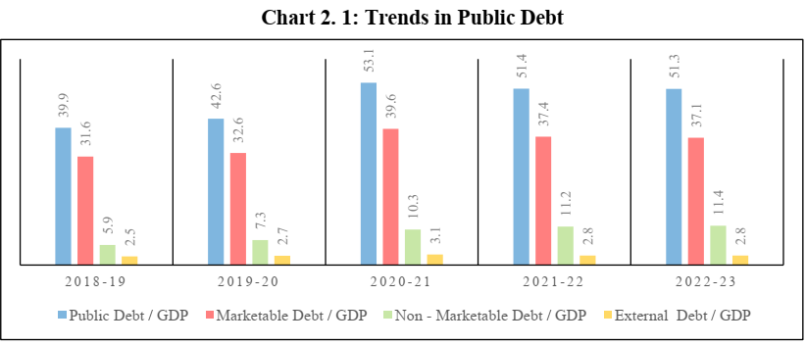

Slide 4
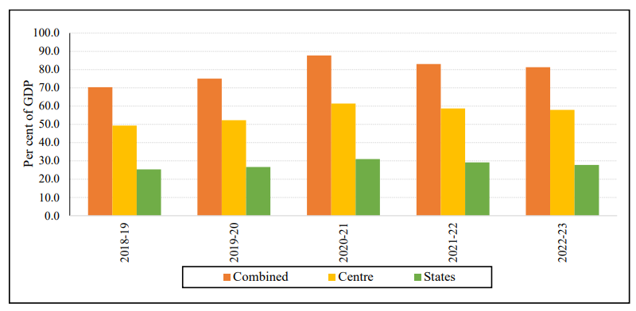
Trends in Debt to GDP Ratio of India

Slide 5
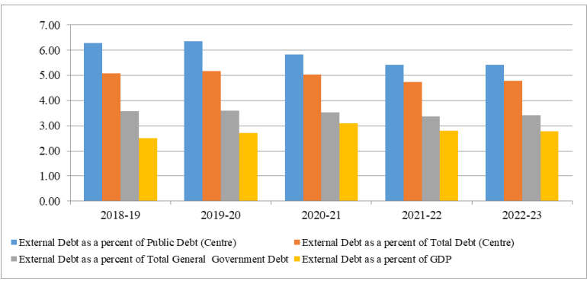
Composition of debt
Trends in External Debt ratios of India

Slide 6
India’s PDM Framework
Broadly, the Department of Economic Affairs (DEA), Ministry of Finance (MoF), GoI is responsible for external debt and non-marketable internal debt securities. The Internal Debt Management Department (IDMD) of the RBI takes care of the marketable securities portion of internal debt.

Slide 7
DMO strategies to reduce debt to sustainable levels
- About 95 percent of India’s debt is domestic- of this internal component the largest chunk comprises of marketable debt.
- Thus, DMS focuses on active management of the marketable debt.
- Benchmarking along with some other guide posts have been outlined, since 2015 Mid Term Debt Strategy (MTDS), with the latest Status Paper/MTDS issued in July 2024 for effective DMS.

Slide 8
DMS – 1. Strategic Benchmark indicators of debt portfolio
Benchmark relating to Weighted Average Maturity of Dated Securities
Indicator | Benchmark (in years) | Leeway (in years)
Weighted Average Maturity of Debt | 12 | ± 2

Slide 9
DMS: 2 Benchmark relating to Weighted Average Maturity of Dated Securities
Indicator | Benchmark (in years) | Leeway (in years)
Weighted Average Maturity of Debt | 12 | ± 2

Slide 10
DMS:3 Benchmark Share of External Debt
Indicator | Benchmark Share (as per cent of public debt) | Leeway (as per cent of public debt)
External debt | 7 | ±3

Slide 11
SAI mandate to audit PD and PDM
As per Article 149 of the Constitution of India read with the provisions of the Comptroller and Auditor General of India (Duties, Powers and Conditions of Service) Act, 1971, it is the duty of the SAI India to audit all receipts and expenditure of the Union Government and State Governments.
As Public debt is a component of receipts of the Union Government it is thus within the scope of SAI India’s audit mandate.

Slide 12
What areas were audited, particularly those relating to PD sustainability
The Performance Audit on Public Debt Management was conducted in 2015 and another study was undertaken in 2020 to assess whether the Government of India:
• had a clear and explicit legal as well as organizational framework for managing Public Debt;
• had a debt management strategy to enable minimization of the risk and cost involved;
• had established an arrangement for effective execution of debt management activities and adopted sound practices in debt servicing;
• had set up effective information systems which enabled a complete and accurate public debt reporting system/debt database, to provide reliable financial information and to meet legal requirements.

Slide 13
Debt Management Strategy met objectives of containing debt cost, risk management and market development.
The MIS / Database provided complete, accurate and reliable public debt reporting and related financial information.
Significantly, at the sub-national levels too, SAI, through its offices across all the 28 provinces, has been regularly examining the issue of public debt and commenting on adequacy of disclosures and its sustainability.

Slide 14
FISCAL INDICATORS COMPUTED & COMMENTED UPON
A. Review of government’s fiscal parameters' viz –
  Revenue Deficit/Fiscal Deficit
  Debt to GSDP/GDP ratio
  Revenue Receipts as a % of GSDP
  Financing pattern of F.D-
  Quantum and maturity profile of Market Borrowings
  Loans from Union Government
  Special Securities against Savings funds etc.
  Components of Public Debt –
  Internal
  External
  Budgeted/Off- Budget Borrowings

Slide 15
Areas of SAI audit observations
Disclosing the undisclosed Off budget borrowings (through PSUs) and commenting on impact on total liabilities.
Maturity profile of public debt with preponderance of short term debt in some provincial governments.
Trends in Debt servicing obligations as a percentage of revenue receipts.
Analysis of Domar Gap to comment on debt sustainability.

Slide 16
SAI reports relied upon for case in Apex Court
The Union exercises an oversight over provincial government borrowings through Article 293(3) and (4) of the Constitution of India which mandates that without the Union government’s ‘consent’, a state may not ‘…raise any loan if there is still outstanding any part of a loan which has been made to the State by the Government of India…’ and that the Union when giving this consent may impose conditions.
In 2023, the Union exercised this power by imposing a Borrowing Ceiling on Kerala state. This meant Kerala couldn’t borrow beyond this amount from any source. Kerala state approached the SC of the country to protest.
In April 2024, National government relied on SAI India’s state Financial Audit reports for PD computation to validate its action and to thereby avoided a SC stay on imposition of borrowing ceiling by GoI.

Slide 17
SAI’s Audit recommendations on PDS/PDM
Legal framework, consisting of both the primary as well as secondary legislation, may include the definition of public debt, debt management objectives, borrowing purposes, and the requirement of debt management strategy. This should be done in a phased manner.
A centralized database of internal debt, external debt and other liabilities may be developed.
Conditions of ‘Finance Plus’ criteria aimed at maximizing access and leverage of
Multilateral Financial Institutions’/Multilateral Development Banks’ knowledge base,international experience and familiarity with best practices may be applied

Slide 18
SAI’s Audit recommendations on PDS/PDM
Steps may be taken to ensure that the public debt information systems support analytical functions.
Mechanism may be developed to ensure consistency in the reporting of public debt by RBI and DEA and amongst the various divisions of DEA.
Recommendation to better manage the cost of market borrowing.

Slide 19
Impact and Way Forward
Off Budget Borrowings have come to a complete halt at the Union Level. At the provincial level, regular reporting on them has resulted in a downward trend in OBB.
PDMC was established in 2016 with a plan to establish a separate DMO in a phased manner. COVID Pandemic halted the efforts but they are now resuming.
- India is now set to attain the goal outlined in the Budget for FY 2021-22 and reach fiscal deficit level below 4.5 per cent of GDP in FY 2025-26. This will have a salutary impact on the debt requirement by the country.
DSA continues to be refined by SAI India
MoUs signed with economic think tanks by SAI India to help with refining the DSA.
WB and IMF Reports on India’s economy and policies have been overall appreciative of the macro economic stability, growth projections and the DMS followed by the country.

Slide 20
Thank You

Slide 21
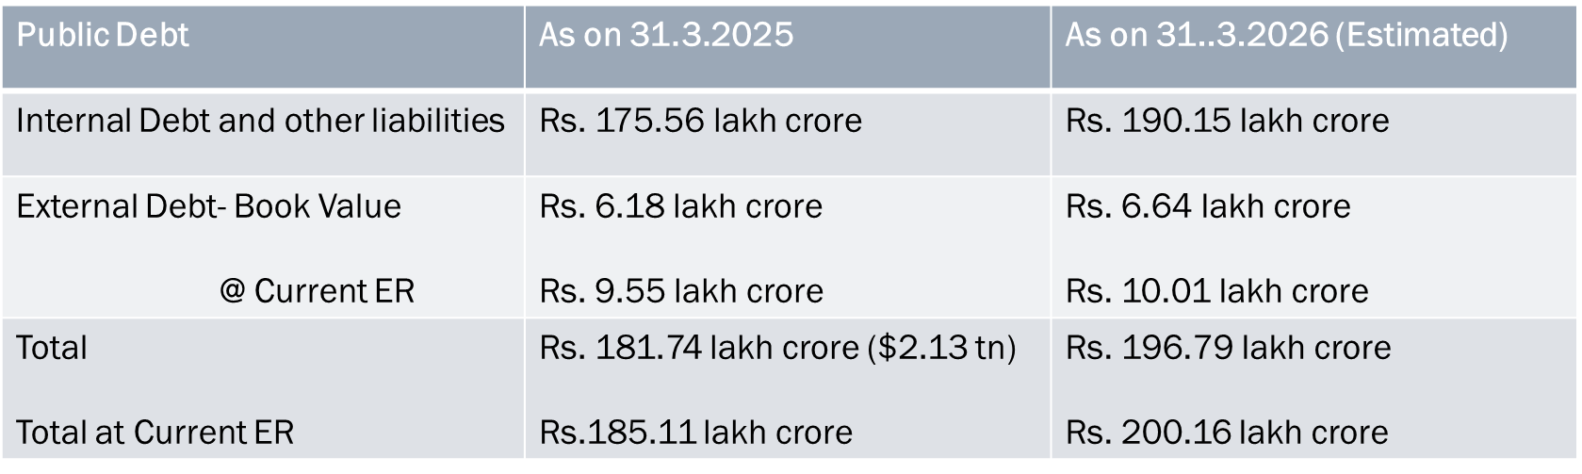
India’s Latest Public Debt Stats
Of the total debt of $ 2.13 trillion, only 3.4 percent is composed of external debt.

