Slide 1


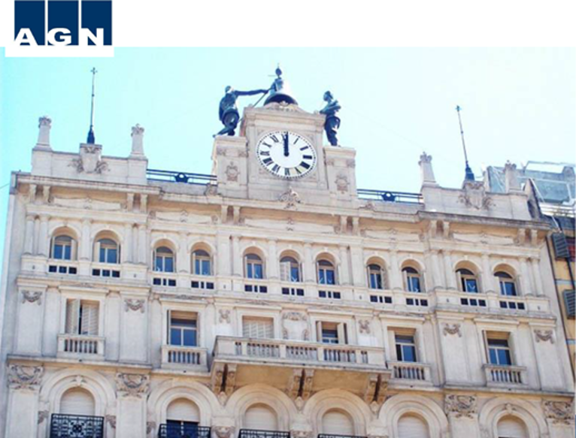
IDI-WGPD Webinar on Public Debt Sustainability
SAI Argentina´s experience
14th May 2025

Slide 2

1. Background a. Argentina’s public debt: its composition, its trends and projections
Notes:
Hello everyone! It is an honor to be part of this webinar and to share the current situation of Argentina´s public debt.

Slide 3
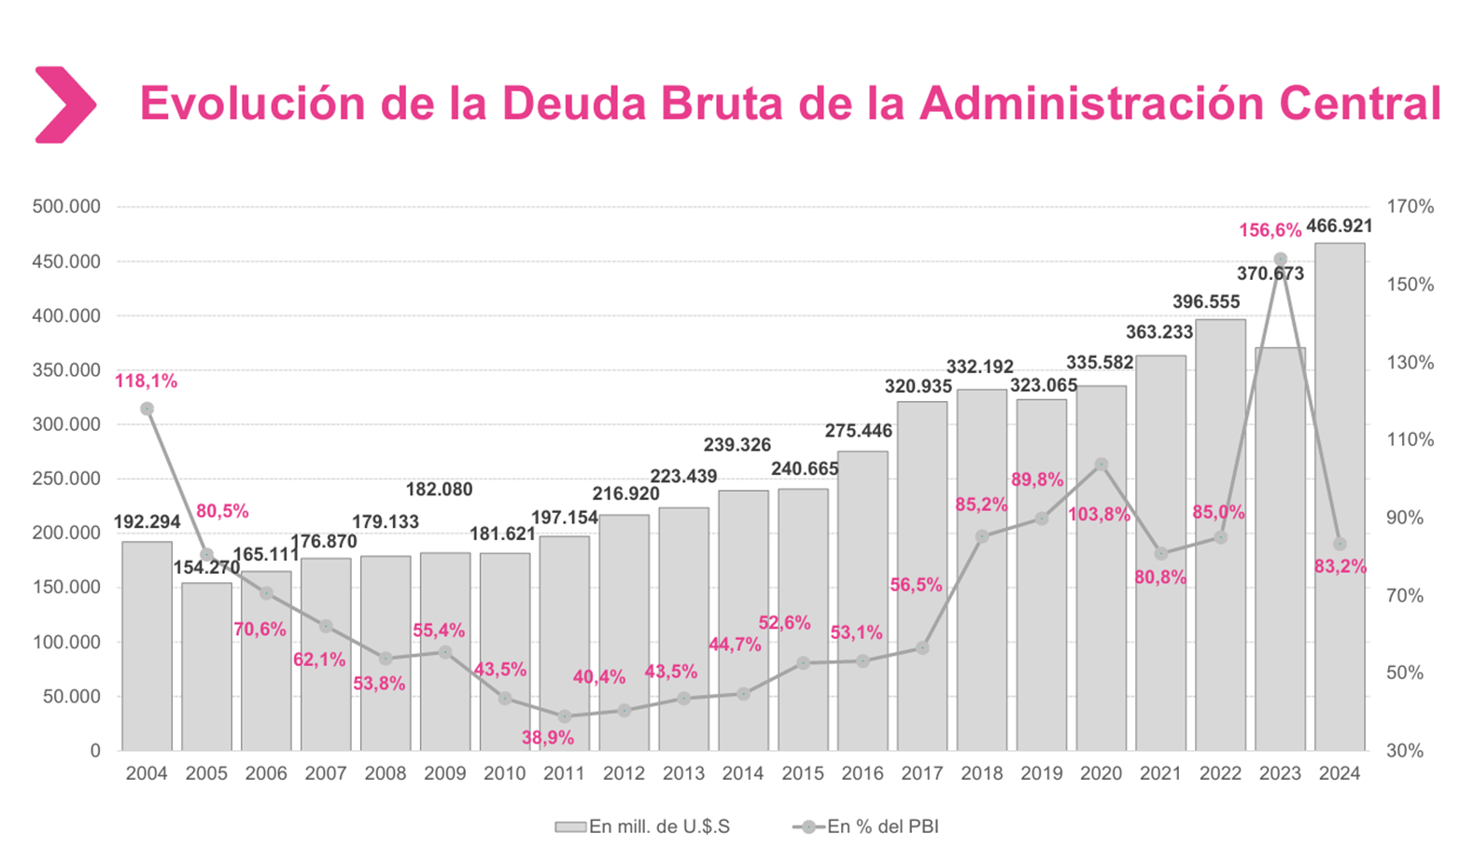
Trends
Evolution of the gross debt of the central administration (mill USD) and % GPD
Source: Ministry of Economy. https://www.argentina.gob.ar/datos-trimestrales-de-la-deuda
Notes:
Argentina’s public debt has been on a strong upward trend since 2016. Nonetheless, at the end of 2024, a sharp drop in the debt-to-GDP ratio was observed because of a strong appreciation of the peso against the dollar.

Slide 4
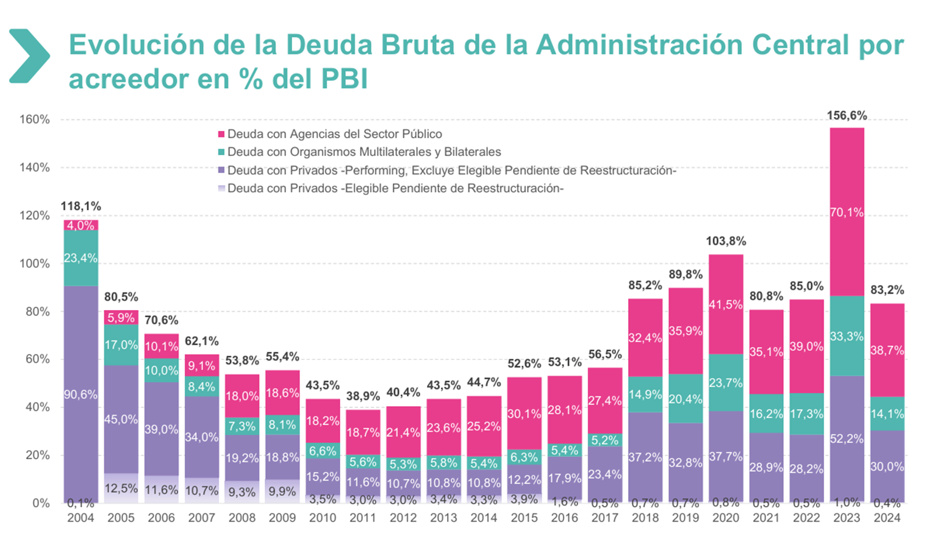
Composition of the Sovereign Debt Portfolio by Creditor
Debt with public sector agencies
Debt with multilateral and bilateral organizations
Debt with private creditors – Performing, excluding eligible debt pending restructuring
Debt with private creditors – Eligible debt pending restructuring
Source: Ministry of Economy. https://www.argentina.gob.ar/datos-trimestrales-de-la-deuda
Notes:
In this slide we can see the composition of gross debt by creditor

Slide 5
Gross Debt Issued by Law: foreign and domestic
Gross Debt (2024)
USD 466,921 M
Source: Elaboration based on data from the Ministry of Economy (https://www.argentina.gob.ar/datos-trimestrales-de-la-deuda)
Notes:
This slide presents the distribution of gross public debt by governing law. As of 2024, 68% of the debt was issued under domestic law, while the remaining 32% falls under foreign law.
This distinction is important for understanding the associated legal and restructuring risks, as domestic law generally provides the issuing country with greater flexibility, giving the country more room for negotiation.

Slide 6
Gross Debt Issued by currency: foreign and domestic
Source: Elaboration based on data from the Ministry of Economy (https://www.argentina.gob.ar/datos-trimestrales-de-la-deuda)
Notes:
The composition of Argentina’s public debt by currency is heavily concentrated in two main denominations: the US dollar (USD), representing 45.08%, and the Argentine peso (ARP), at 44.83%. Other currencies, such as the Special Drawing Rights (XDR) at 8.73% and the Euro (EUR) at 1.26%, account for a smaller share. The remaining currencies—including JPY, CHF, CAD, GBP, among others—make up less than 1% of the total.

Slide 7
Debt Portfolio by Type of Instrument
Debt Portfolio by Type of Interest Rate​
Source: Elaboration based on data from the Ministry of Economy (https://www.argentina.gob.ar/datos-trimestrales-de-la-deuda)
Notes:
In relation to type of instrument, the majority of public debt is issued in public bonds.
As regards to interest rate, the majority of debt is issued with fixed interest rate.

Slide 8
Maturity Profile of Gross Debt by term (mill USD)
Short-Term
Mid-Term
Long-Term
Source: Elaboration based on data from the Ministry of Economy (https://www.argentina.gob.ar/datos-trimestrales-de-la-deuda)
Notes:
Then, debt maturities are heavily concentrated in the short term, especially in 2025, wich creates significant financial pressure. This shows that the market has doubts about the solvency of Argentina´s debt, wich es made up 70% of bonds…
It must be considered that 40% of the capital payments projected for year 2025 correspond to public sector agencies, which lowers rollover risk.

Slide 9
Public Debt Bonds Exchanged under Local and Foreign Legislation
Yield curve in 2025
Yield curve of dollar-denominated securities in 2025
List of Debt Exchange Bonds
Source: Elaboration based on the daily report from IAMC 4-4-2025. https://www.iamc.com.ar/informediario/
Notes:
So the 2025 yield curve appears inverted, reflecting a signal of distrust and deepening credit risk.
9

Slide 10
1. Background b. Argentina’s public debt sustainability
Notes:
We will now present some current indicators of the sustainability of Argentina's debt

Slide 11

Definition of Sustainability
In general terms, public debt can be regarded as sustainable when the primary balance needed to at least stabilize debt under both the baseline and realistic shock scenarios is economically and politically feasible, such that the level of debt is consistent with an acceptably low rollover risk and with preserving potential growth at a satisfactory level.
In general, the classic indicator is the Debt-GDP ratio.
This ratio normalizes the information in such a way that it becomes
comparable among countries.
Ratio in the Argentine case
$\frac{Stock Deuda Bruta 2024 }{PBI 2024}$ $=83,19\%$
Notes:
The sustainability of public debt is a key concept in macroeconomic and fiscal análisis.

Slide 12
Sustainability Indicators
However, the true debt and fiscal solvency of a country is based on:
Composition of the sovereign debt portfolio by creditor
Composition by type of instrument: Government securities, loans, special agreements
Composition by interest type: fixed/variable
History of Renewal or Credit Risk
Ability to defend against unexpected external events (black swan events)
Notes:
We have already seen some indicators, and now let´s look at others…

Slide 13
Renewal or Credit Risk History.
Evolution of Country Risk (EMBI+ Argentina) from 2014 to 2024
Source: Elaboration based on data of the EMBI+ (Emerging Bond Index Plus), an indicator created by JP Morgan as at December 31 of each year.
Notes:
The evolution of country risk and the interest-to-GDP ratio show some improvement in 2024, but remain at high levels. This shows that there are still problems that make sustainable financing and growth dificult.
13

Slide 14
How much does national primary fiscal superavit in terms of GDP need to cover the interest on the debt?
Public debt interest-to-GDP ratio 10 years before
Source: Elaboration based on data from the Ministry of Economy (https://www.argentina.gob.ar/datos-trimestrales-de-la-deuda) and INDEC (National Institute of Statistics and Census) (https://www.indec.gob.ar/indec/web/Nivel4-Tema-3-9-47)
Notes:
This slide illustrates the interest-to-GDP ratio over the past ten years, showing the proportion of national income required solely to service interest payments on public debt. The chart highlights key periods of stress, notably in 2018 and 2019, when interest payments peaked at nearly 5% of GDP. Although the ratio declined in 2021 and 2022, it rose again in 2023, reflecting renewed fiscal pressure. This indicator underscores the fiscal effort needed—through primary surpluses—to meet debt obligations and maintain sustainability.
14

Slide 15
Ability to defend against unexpected external events (black swan events)
Debt Services paid as a percentage of Tax Revenues from 2014 to 2024
Debt Interest paid as a percentage of Tax Revenues from 2014 to 2024
Source: elaboration based on data from the Ministry of Economy. https://www.argentina.gob.ar/datos-trimestrales-de-la-deuda
Source: elaboration based on data from the Ministry of Economy. https://www.argentina.gob.ar/datos-trimestrales-de-la-deuda
Notes:
The same happend with the fiscal pressure from interest payments. Although interest payments stabilized, total debt service remains very high.
15

Slide 16
Other solvency indicators…
External Debt as a percentage of Exports from 2014 to 2024
External Debt as a percentage of International Reserves from 2014 to 2024
Source: Elaboration based on data of the Ministry of Economy. https://www.argentina.gob.ar/datos-trimestrales-de-la-deuda
Source: Elaboration based on data of the Ministry of Economy. https://www.argentina.gob.ar/datos-trimestrales-de-la-deuda
Notes:
It´s also important to see how external debt compares to exports and reserves. These indicators are still weak, so the country, in this case Argentina, has less capacity to handle external shocks.

Slide 17
Other solvency indicators…
Debt and External Debt as % GDP in 2000 to 2024 (september)
Source: Elaboration based on data of the Ministry of Economy. https://www.argentina.gob.ar/datos-trimestrales-de-la-deuda
Notes:
After each restructuring, the debt-to-GDP ratio goes down, but it raises again soon after.

Slide 18
Other solvency indicators…
Debt Services and interest paid as % GDP from 2000 to 2024 (september)
Source: Elaboration based on data of the Ministry of Economy. https://www.argentina.gob.ar/datos-trimestrales-de-la-deuda
Notes:
In 2002, debt services fell to 0% because Argentina declared default in 2001. After that, interest payments remain stable.

Slide 19
Other solvency indicators…
Debt Services and interest payments projections from 2024 to 2089
Source: Elaboration based on data of the Ministry of Economy. https://www.argentina.gob.ar/datos-trimestrales-de-la-deuda
Notes:
In the future, debt will remain high, but the agreement with the IMF is followed, payments could be better distributed and more manageable, helping to keep Argentina´s finances in order.

Slide 20
Argentine history of debt restructuring
Notes:
We shall now introduce the Argentine history of debt restructuring. This provides key insights into how debt crises were managed over time, and how structural challenges continue to shape the country’s public debt dynamics.
20

Slide 21
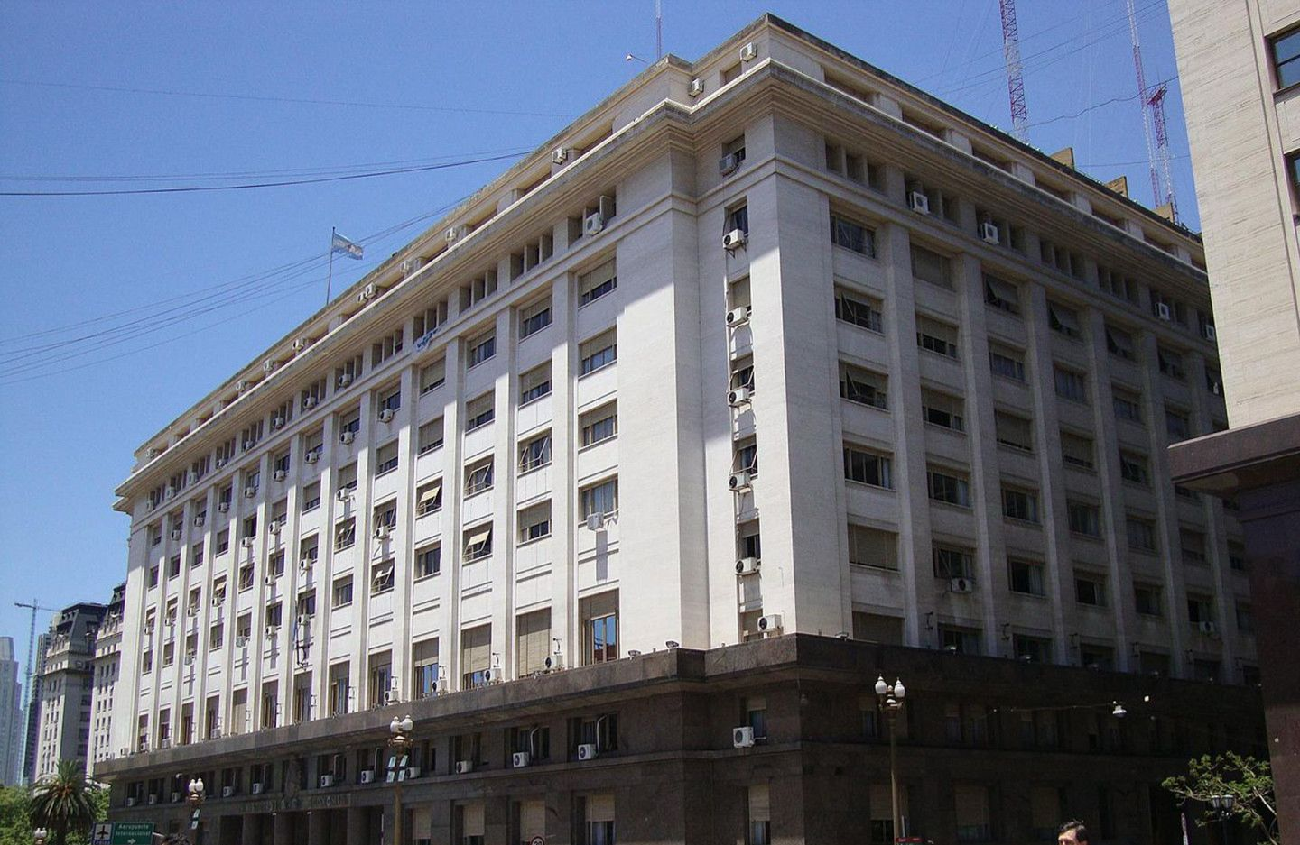
Debt strategies developed and implemented by the DMO in order to reduce debt at sustainable levels
Notes:
21

Slide 22
2004 and 2005
Public debt restructuring under foreign legislation
Reopening in 2010

Slide 23
2004/05 Debt Restructuring
Situation prior to the EXCHANGE:
  Residual capital in circulation: U$S 79.7 billion
  Accrued and unpaid interest: U$S 2.1 billion
Exchange Proposal:
  Reduction in the number of bonds
  Offer of instruments under Argentine legislation
  Capital haircut:
  2010: Exchange reopening
New Bond | Swap ratio per unit amount in debt restructuring
Par | 1.000%
Discount | 0.337%
Quasi-par | 0.699%
Source: executive order 1735/04, Annex II, Prospectus Supplement.
Notes:
After Argentina declared a default on its public debt in 2001, the restructuring process initiated in 2004/05, with an outstanding capital nearly 80 billion dollars, plus unpaid interests.
In this big first attempt to normalize the debt situation, the official proposal focused on three key elements:
- reducing the number of instruments in circulation,
- simplificating the applicable legal frameworks —limited to New York, UK, Japan, and Argentina itself
- applying a significant capital cutback or haircut.
This haircut wasn´t the same for everyone and the outcome depended on which bond investors held: as Discount bondholders faced the biggest hit (a 66% reduction with a swap ratio of about 0.337), part of bondholders actually saw no nominal reduction and kept the principal value (Par bondholders), while quasi-Par bondholders faced only a 30.1% cutback).
An interesting fact is that new bonds were issued retroactively from 2003, and the interest that have accrued in that time was paid out in cash, considering this as an incentive to encourage people to accept the deal.
In 2010, the offer was reopened, allowing more bondholders to join. This was a key step toward normalizing the country's debt structure after the 2001 default.

Slide 24
2004/05 Debt Restructuring
Exchange results
Global results
Eligible debt | 81.836
Exchanged debt | 62.318
Acceptance rate | 76.15%
Type of Bond | Old Debt Exchanged (Offers) | New Debt (Issuances) | Discount
Par Bonds | 15.000 | 15.000 | 0%
Discount Bonds | 35.405 | 11.932 | -66.3%
Quasi-par Bonds | 11.913 | 8.329 | -30.1%
Total | 62.318 | 35.261 | -43.4%
Notes:
The results of the exchange were significant: high participation (over 76%) and big nominal reduction (with an average nominal haircut of about 43.4%), and improvement of the debt profile.
The reduction in the debt burden is basically due to Discount bonds, as they were the most accepted offers and took the biggest haircut.

Slide 25
2004/05 Restructuring and 2010 Reopening
Debt balances post-exchange
 | 2004/2005 Exchange |  |  | 2010 Reopening
Gross balances in millions of USD | Pre-exchange 31/12/2004 | Post-exchange 30/06/2005 | Var % | Pre-exchange 31/12/2009 | Post-exchange 31/12/2010 | Var %
Public debt stock | 191.296 | 126.466 | -34% | 147.119 | 164.330 | 12%
In normal payment situation | 80.928 | 119.130 | 47.20% | 140.399 | 157.582 | 12.24%
Debt in deferred payment status | 65.038 |  |  | 475.9 | 6.748 | 1318%
Debt pending restructuring |  | 23.381 |  | 29.808 | 11.218 | -62.36%
Source: Fiscal Bulletin
Notes:
The 2005 deal cut the public debt stock by about 34%, which was significant, and the amount of Debt in normal payment status increased by 47%.
And even the 2010 reopening did not lower the total debt stock, it allowed more bondholders to join, reducing the amount still in default by over 60%. So it reduced the litigation risk significantly, as since new bonds required holders to waive legal claims.
These two processes regularized over 90% of defaulted debt and laid the groundwork for Argentina’s gradual return to capital markets.
However, not all bondholders accepted the voluntary offer and remained outside the restructuring (later known as holdouts), leading to subsequent legal disputes. This issue kept unresolved until 2016, when the Argentine government reached a settlement with them.

Slide 26
Last AGN Report on
Public debt restructuring under foreign legislation (2020) https://www.agn.gob.ar/informes/Informe-54-2025

Slide 27


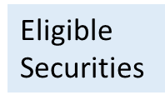
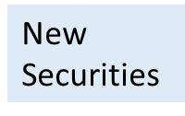
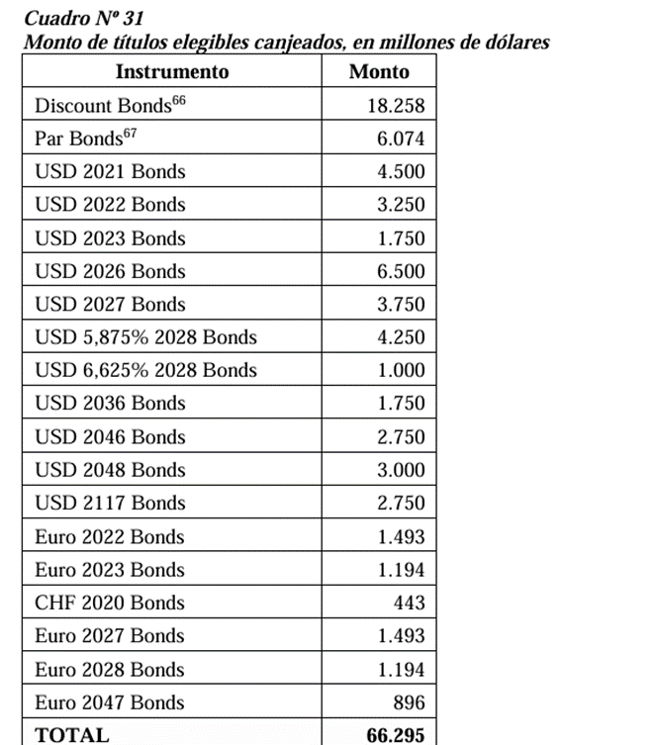
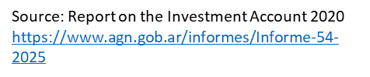

Public debt restructuring under foreign legislation​
Amount of elegible securities exchanged in Millions of Dollars
Amount of New Bonds Issued, in Millions of Dollars
Instrument | Amount
Global Bonds in USD 2030 | 16,091
Global Bonds in EUR 2030 | 1,392
Global Bonds in USD 2035 | 20,502
Global Bonds in EUR 2035 | 357
Global Bonds in USD 2038 | 11,405
Global Bonds in EUR 2038 | 967
Global Bonds in USD 2041 | 10,482
Global Bonds in EUR 2041 | 1,878
Global Bonds in USD 2046 | 2,092
Global Bonds in EUR 2046 | 296
TOTAL: | 65,462
Notes:
Now, let´s talk about the recent restructuring in 2020, wich covered both external and domestic debt.
The debt restructuring under foreign legislation involved over 66 billion dollars in eligible securities, including near-term maturities —such as 2021 and 2022 bonds— as well as longer-dated instruments like the Discount and Par bonds (from the previous restructuring).
The main goal of the offer was sustainability without big cuts, so it focused more on making payments more manageable over a longer period of time than in cutting the principal amount (new bonds maturities ranged from 2030 to 2046).
Nearly the entire eligible stock was effectively restructured, providing short-term debt relief without applying a significant nominal haircut.
In addition to extended maturitirs, the Exchange lowered borrowing costs as the agreement reduced the weighted average interest rate.

Slide 28


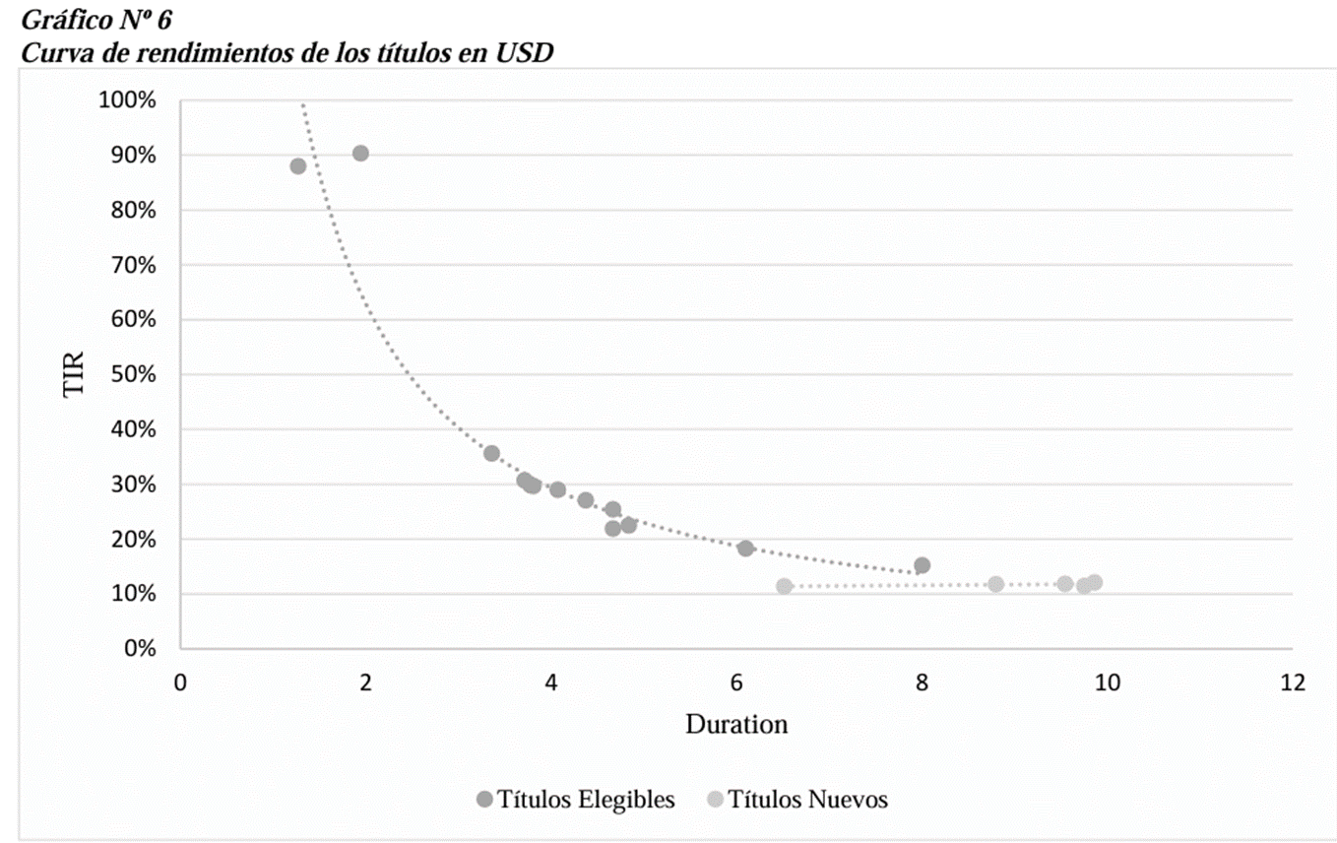
Public debt restructuring under foreign legislation
Yield curve in 2020
Yield curve dollar denominated securities under foreign legislation
eligible bonds
new bonds
Source: Investment Account Report 2020 https://www.agn.gob.ar/informes/Informe-54-2025
Notes:
The market reacted somewhat positively to the 2020 debt restructuring under foreign law, as the yield curve improved substantially.
The internal rate of return (IRR) on new securities dropped significantly compared to the eligible ones.
Thus, the lower yields for short-term bonds flattened the curve (and reversed its slope), signaling increased market confidence.

Slide 29

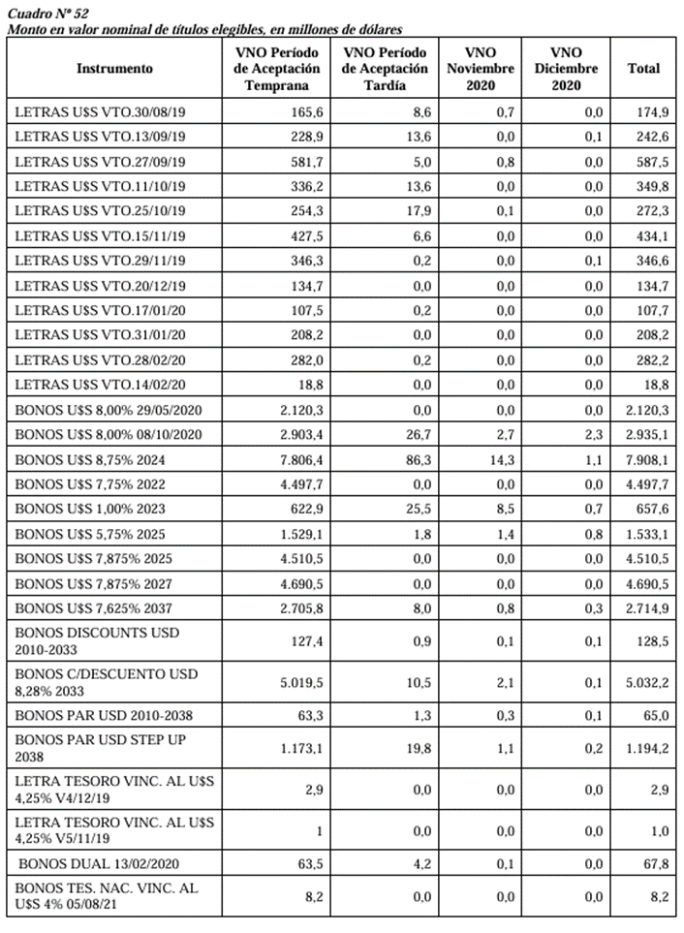

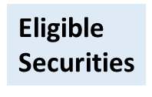
Public debt restructuring under national legislation
Nominal Value of Eligible Bonds, in Millions of Dollars
Nominal Value of New Bonds, in Millions of Dollars.
Instrument | Face Value Early Acceptance Period | Face Value Late Acceptance Period | Maturity November 2020. | Maturity December 2020. | Total
Bonds USD 2030 | 12.422,9 | 156,5 | 20,0 | 1,7 | 12.601,1
Bonds USD 2035 | 18.448,5 | 15,2 | 2,3 | 2,7 | 18.468,7
Bonds USD 2038 | 7.195,7 | 14,9 | 2,9 | 0,2 | 7.213,7
Bonds USD 2041 | 1.467,6 | 23,8 | 1,6 | 0,3 | 1.493,3
Boncer 2026 2% | 718,3 | 9,2 | 3,2 | 0,4 | 731,1
Boncer 2028 2.25% | 24,4 | 0,5 | 0,0 | 0,1 | 25
TOTAL | 40.277,4 | 220,1 | 30 | 5,4 | 40.532,9
Source: Investment Account Report 2020 https://www.agn.gob.ar/informes/Informe-54-2025
Source: Investment Account Report 2020 https://www.agn.gob.ar/informes/Informe-54-2025
Notes:
Alongside the foreign-law restructuring, the Argentine government also restructured domestic-law bonds (over 41 billion dollars).
This involved various local instruments —including short-term bills, discount and par bonds— replacing them with a new set of bonds featuring longer maturities (between 2030 and 2041).
New bonds also include 2 bonds indexed to CER, which is a local inflation measure, offering some inflation protection for local bondholders.
Participation rate domestically was really high (98%), resulting in almost 1 billion dollars of relief through reductions in principal and accrued interest.
The weighted average interest rate on the domestic side also dropped (by 4.35 percentage points), while the average life of this domestic bonds shortened by almost 5 years.

Slide 30
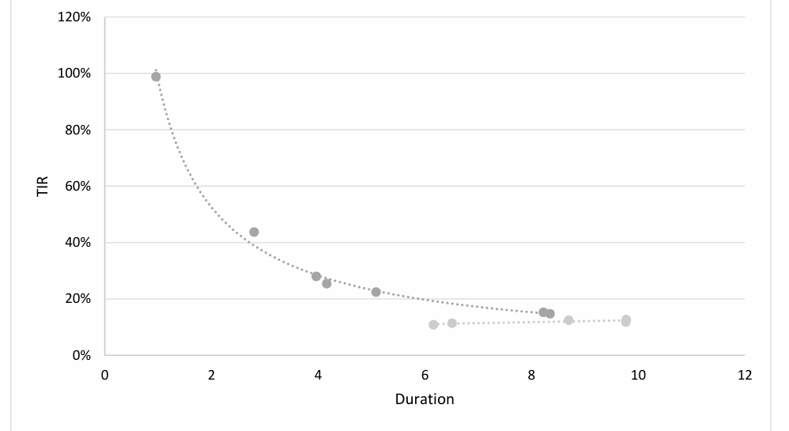
Public debt restructuring under local legislation
Yield curve in 2020
Yield curve dollar denominated securities in USD under local legislation
Elegible Securities
New Securities
Source: Investment Account Report 2020 https://www.agn.gob.ar/informes/Informe-54-2025
Notes:
With the domestic debt swap, perceived risk also significantly improved, as yields on the new bonds dropped considerably, flattening the curve (and reversing the slope).
The Exchange improved the maturity profile as average duration increased.
However, interest rates on the new local bonds stayed a bit higher than those under foreign law, reflecting market concerns over domestic economic, legal and institutional enviroment.
Overall, the transaction helped stabilize expectations and reduce pressure on local financing sources.
30

Slide 31

SAI Argentina´s Mandate related to the Audit of public debt and public debt management
Notes:
Now we continue with the Argentine case, specifically the 2020 public debt restructuring. This process was evaluated by the Supreme Audit Institution of Argentina (Auditoría General de la Nación) in the 2020 Investment Account report. The implemented strategy and its compliance were analyzed
31

Slide 32
SAI Argentina´s mandate
National Constitution, Article 85
Law 24,156 (Financial Administration Law), Title VII, Article 116 establishes the Auditoría General de la Nación as an external control entity, dependent on the National Congress of Argentina.
Scope of its Competence: The subsequent external control of budgetary, economic, financial, patrimonial, and legal management, as well as the issuance of opinions on the financial statements of the central administration, decentralized agencies, state-owned companies and corporations, regulatory bodies for public services, the local government of Buenos Aires, and private entities awarded privatization processes, in relation to the obligations arising from the respective contracts.
The Law also includes entities that receive, spend, or manage public funds under a legal norm or for a public purpose
Notes:
Thank you, Cecilia, and colleagues. A warm greeting to you all.
It is my role for this part of the session to share with some aspects of SAI Argentina´s mandate.
This is referenced in Article 85 of the Argentina´s National Constitution, which states that external audit of the national public sector is a responsibility of the Legislative Branch whose opinion regarding the performance and overall situation of public administration is based on the reports issued by our SAI in its role of technical advisor to National Congress, with functional autonomy.
It´s a wide mandate and in general, may include any entity that receives, spends, or manages public funds or funds with a public purpose.
32

Slide 33
SAI Argentina´s mandate
The Supreme Audit Institution of Argentina (Auditoría General de la Nación) designs and proposes its own Annual Operational Plan, which is approved by the National Congress. It exercises its technical competence by applying the three types of audits (ISSAI 100):
General Framework: Res. 26/2015 NCEG
Financial Control: Res. 185/2016 AGN
Management Control: Res. 186/2016 AGN
Compliance Control: Res. 187/2016 AGN
Public Debt Audit: Res. 188/2016 AGN
Notes:
To fulfill this mandate, our SAI is empowered to carry out all three types of audits: financial, performance, and compliance detailed in ISSAI 100 an our SAI´S Government External Control Standards.
This regulation was the beginning of a deep regulatory reform with the purpose of aligning SAI Argentina´s standards with international audit standards and core auditing principles
33

Slide 34
SAI Argentina´s mandate: public debt audit
Article 118, Section 24.156, Functions related to public debt auditing:
b) Conduct financial, legality, and management audits, special examinations of the jurisdictions and entities under its control, as well as evaluations of programs, projects, and operations.
c) Audit, either directly or through independent audit professionals, the executing units of programs and projects financed by international credit organizations, in accordance with the agreements reached between the Argentine Nation and these organizations for these purposes.
e) Control the application of resources from public credit operations and conduct special examinations necessary to form an opinion on the situation of this indebtedness.
g) Conduct special examinations of acts and contracts of significant economic importance.
This mandate is not specifically related to debt sustainability but is very broad, allowing the Supreme Audit Institution of Argentina (Auditoría General de la Nación) to carry out this type of control work.
Notes:
The Financial Administration Law enables audit of debt-related programmes and operations, including those financed by international financial institutions, and acts and contracts of economic relevance. Although public debt sustainability is not explicitly included, the legal framework provides sufficient authority to conduct such audits.
34

Slide 35
SAI Argentina´s mandate: public debt audit
Public Debt Control Management
Department of Control of Indebtedness with International Financial Organizations
Department of Control of Public Credit Operations and Sustainability
Notes:
As part of these responsibilities, SAI Argentina has Management Office for Public Debt Audit, which includes a Department to audit Public Debt Operations and Sustainability. whose primary responsibility is to “plan, coordinate, supervise, and carry out audits and reviews of the public debt, its sustainability and the related contingent risks.”
Any type of audit—compliance, financial, or performance—can be applied to the matter, or a combination of them, according to what is established in our SAI´s Operational Plan.
35

Slide 36
Audit reports related to public debt sustainability
Notes:
.
36

Slide 37
Tools or parameters used in Debt Sustainability
Notes:
We will now introduce tools and parameters that SAIs can apply in their control work when auditing debt sustainability.
37

Slide 38
Examples of Sustainability indicators calculated for analysis
Report: INVESTMENT ACCOUNT – CHAPTER ON PUBLIC DEBT. Fiscal year 2008
Audit Object: Investment Account
Main Topic: Financial Audit fiscal year 2008
Indicators and analysis of the Capacity to Pay:
  Present Value of Debt
  Primary Surplus requested to sustain debt repayment capacity
Primary Surplus requested to sustain Debt repayment capacity
s'= (((1+r) / (1+g)) – 1)d
Where:
s´: primary surplus requested
r : cost of funding
g: GDP growth in real terms
d: Debt/GDP ratio
Notes:
As fiscal sustainability is central to debt sustainability and could be considered a core issue in the long term, our SAI applied this indicator of fiscal sustainability in the Financial Audit of fiscal year 2008, focusing on the national government’s repayment capacity.
The indicator is based on the primary surplus (taht is budget balance before interest payments) required to stabilize the public debt-to-GDP ratio.
The formula connects the real interest rate the government pays, the real growth rate of the economy, and the current debt to GDP level.
A certain primary surplus is needed just to stand still. When the interest rate exceeds economic growth, the country must generate a higher primary surplus to prevent the debt ratio from rising.
This kind of tools allow SAIs to assess the sustainability of the fiscal path under different scenarios, without needing to simulate future debt services in detail.
38

Slide 39
Examples of Sustainability indicators calculated for analysis
Report: INVESTMENT ACCOUNT – CHAPTER ON PUBLIC DEBT. Fiscal year 2008
Results: Primary Surplus requested to sustain Debt as % of GDP under different D/GDP scenarios
Notes:
This slide shows the empirical application from 1993 to 2008 of the sustainability indicator under different public debt-to-GDP scenarios, each with a corresponding primary surplus requirement.
Throughout most of the period, Argentina’s actual fiscal outcome fell short of the threshold needed to stabilize the debt. Only between 2003 and 2007 the primary surplus exceeded the sustainability requirement across all scenarios, thanks to strong economic growth and some fiscal adjustment, related to the debt Exchange.
In the rest of the period, the margin was tighter—or even negative—highlighting the vulnerability of public finances outside of those boom years.
This kind of forward-looking sustainability analysis is useful to anticipate structural risks and design more resilient fiscal policies in the face of potential economic or financial shocks…. So, it helps policymakers to see if they're heading for troubles…
39

Slide 40

A Country's Debt Capacity - Critical Variables (IMF): ex. Argentina
Macroeconomic
hey help understand the general macroeconomic context and estimate fiscal revenues and financing costs
Fiscal
Financial and Structural Sector
hey help project the dynamics of the debt and assess fiscal solvency
Used to analyze financial transmission channels and contagion risks between the sovereign and the financial system
Fiscal Risk (historical)
Macroeconomic fundamentals (volatility)
Balance of Payment: external restrictions
Demographic, Social, and Climate Change (optional)
Governance and Structural Risks
Part of the long-term structural risks, and they help capture future fiscal pressures
They Incorporate qualitative aspects that affect the credibility of fiscal policies and the risk perception by markets
Notes:
Now, we bring IMF's view on specific vulnerabilities. This diagram summarizes the critical variables identified by the IMF in the DSA Analysis.
In Argentina’s case, three of them stand out as particularly relevant due to Argentina's history with persistent structural imbalances and external vulnerabilities.
First, fiscal variables are key: Persistent deficits that mean constant borrowing needs plus heavy debt burden, and in addition, relying on monetary financing, printing money, or external borrowing just makes the country more exposed to shocks and complicate rollover prospects. This creates a kind of built-in fragility.
Second, macroeconomic fundamentals— such as GDP growth, the current account balance, interest rates, and exchange rates. These fundamentally shape the country's ability to actually pay back its debts.
And finally, Argentina’s external restriction—the balance of payments constraint—plays a central role. The chronic shortage of foreign currency is a key source of macroeconomic instability.
Limited access to foreign currency limits imports and constrains economic growth. Also fuels inflation and generate negative interest rates in real terms for extended periods of time. Additionally puts huge pressure on the exchange rate and drains reserves. All this directly impacts debt service in foreign currency.
All these problems are amplified with cyclical crises, which are often triggered by external shocks (such as commodity prices swings and global capital flows), but also by internal policy issues (like abrupt fiscal adjustments or confidence crises).
Together, these factors increase fiscal risk and market uncertainty, increase rollover risks, and ultimately heighten fiscal vulnerability making debt sustainability a constant challenge.

Slide 41
Examples of Audited Topics - Findings and Recommendations
Analysis of Program Performance 22 – Ministry of Finance (Debt Strategy)
Public debt - Arrangement with the International Monetary Fund. Impact on solvency and sustainability. Specialized audit of public debt 2018 – 2019
Audit Object: Program 22 – Ministry of Finance
Main Topic: Public Debt Strategy
Audit Period: 01/01/2015 - 30/06/2016
Type of Control: Compliance and Management
Main Audit Question: Was a debt management strategy formulated and implemented within the framework of Objective II of Program 22 during 2015 and 2016 in accordance with best practices?
Audit Object: Arrangement with the International Monetary Fund (IMF). Impact on Solvency and Sustainability
Main Topic: Debt with International Financial Institutions
Audit Period: 2018-2019
Type of Control: Management-Compliance
Main Audit Question: Was the Stand-By Arrangement (SBA) undertaken within due diligence processes and procedures that ensure efficiency and effectiveness in debt management?
Notes:
Continuing with the topics Cecilia referred, I Will share with you some examples of findings and recommendations from reports related to the subject we are discussing.
We have chosen to present to you two audit reports
- Audit of Programme 22 – about Debt Strategy
- Specialised Audit of the IMF Agreement (year 2018–2019)
41

Slide 42
Examples of Audited Topics - Findings and Recommendations
Analysis of Program Performance 22 – Secretariat of Finance (Debt Strategy)
Sources of Audit Criteria:
ISSAI 5411, 5422
Guidelines for Auditing Public Debt Management 2012
Debt Management Performance Assessment Tool – World Bank (DeMPA)
Principles on Promoting the Responsibility of Sovereign Borrowing and Lending (UNCTAD 2012)
Revised Guidelines for Public Debt Management (World Bank and IMF)
Notes:
Let us begin with the report concerning the debt strategy.
This audit laid the foundation for a robust approach to debt management assessment. It has since been followed by further audits, particularly within the Accountability Report process. Audit criteria included ISSAI Level 4 standards applicable to public debt at that time, the 2012 IDI-WGPD Guidelines, the World Bank’s DeMPA tool, UNCTAD’s Principles on Responsible Sovereign Lending and Borrowing, and IMF/World Bank revised debt management guidelines.
42

Slide 43
Examples of Audited Topics - Findings and Recommendations
Analysis of the Performance of Program 22 – Ministry of Finance (Debt Strategy)
Main Findings:
Lack of guidelines and a debt management strategy in the terms proposed by best practices.
The function of formulating a strategy is not expressly defined and delineated in the current regulations.
The audited entity equates the debt management strategy with the budget, meaning that the estimation of debt needs is related to the budget formulation process.
The audited entity does not define medium-term debt management objectives according to sound practices, nor does it set targets, assign responsibilities for their creation, or establish measurement parameters.
The audited entity analyzes the risks of the existing public debt portfolio structure, although in a non-systematic way and does not include a risk mitigation plan for the audited period.
The audited entity does not identify contingent liabilities within the framework of a strategy. The ones it identifies follow current regulations and are not addressed with the breadth required by best practices.
Notes:
The audit found that the auditee lacked a formal debt strategy and that no function related to it had been clearly defined in regulations. the auditee equated the task with estimating borrowing needs within the framework of budget preparation. There was also a lack of systematic risk analysis and comprehensive identification of contingent liabilities.
43

Slide 44
Examples of Audited Topics - Findings and Recommendations
Analysis of the Performance of Program 22 – Ministry of Finance (Debt Strategy)
Recommendations:
Although the formulation of a debt management strategy in the terms defined by best practices is not a specific function of the Ministry of Finance, it is recommended to create such a document, document it, and publish it.
As an interim step, it is recommended to at least formulate general guidelines for the evolution of specific indicators for interest rate, refinancing, and foreign currency risks.
It is recommended to clearly define medium-term objectives for debt management within the framework of developing a strategy or, at a minimum, agree on them with the senior authority (Minister of Finance) and document them clearly.
Systematize or standardize the content of the risk analysis and outline a risk mitigation plan for the identified risks. Progress in calculating sustainability and vulnerability indicators in terms of best practices, as well as including simulation exercises and considering contingent liabilities in the design with the breadth determined by best practices.
Notes:
Recommendations included developing a debt strategy based on sound practices, establishing broad guidelines, calculating sustainability and vulnerability indicators, and defining medium-term management objectives. A broader approach to contingent liabilities was also advised.
44

Slide 45
Examples of Audited Topics - Findings and Recommendations
Public debt - Arrangement with the International Monetary Fund. Impact on solvency and sustainability. Specialized audit of public debt 2018 – 2019
Sources of Audit Criteria:
National Constitution;
Law 24.156 on Financial Administration and Control Systems of the National Public Sector (“LAF”) and Regulatory Decree 1344/07 (among others, specific to the subject matter);
GUID 5250;
Debt Management Performance Assessment Tool – World Bank (DeMPA);
Principles for the Promotion of Responsible Sovereign Loan Granting and Borrowing (UNCTAD 2012);
Revised Guidelines for Public Debt Management, IMF 2014.
Notes:
Another relevant report from our SAI concerns the 2018 agreement with the IMF. The sources of audit criteria National Constitution, Financial Administration Law, and regulations on proper advisory, transparency, and administrative procedures. It also considered sound practices such as GUID 5250, DeMPA tool, UNCTAD Principles, and the IMF’s 2014 Guidelines.
45

Slide 46
Examples of Audited Topics - Findings and Recommendations
Public debt - Arrangement with the International Monetary Fund. Impact on solvency and sustainability. Specialized audit of public debt 2018 – 2019
Main Findings:
The Agreement was signed by the Minister of Finance, who did not have the authority to manage or authorize public debt.
Article 61 of the Financial Administration Law was not complied with.
The applicable procedure for the authorization, negotiation, contracting, administration, and control/supervision of multilateral loans was not implemented.
The Agreement did not have prior involvement of the Internal Audit Unit.
The definitive document of the Agreement could not be found (there were multiple versions).
The Legal Opinion was issued after the deadline and was based on a regulation that was not in force at the time of the Agreement. The legal advice was neither timely nor efficient.
The Ministry of Finance did not conduct an analysis of the costs and financial risks, nor of solvency and sustainability.
The management process was neither effective nor efficient in terms of accountability, transparency, and control in the use of funds.
During the period of the Agreement, a significant and continuous capital outflow was observed. The implementation of measures to prevent it was delayed.
Notes:
Key findings included the absence of proper authorisation and competence. Article 61 of the Financial Administration Law was breached, as no opinion was obtained from the Central Bank on the operation’s impact on the balance of payments. Core institutions like the Cabinet Office, Budget Office, and Internal Audit Unit were not involved. There was also a lack of several análisis like cost–risk, repayment and solvency, among others.
46

Slide 47
Examples of Audited Topics - Findings and Recommendations
Public debt - Arrangement with the International Monetary Fund. Impact on solvency and sustainability. Specialized audit of public debt 2018 – 2019
Main Findings:
The conditions related to currency, amount, and term of the Agreement with the IMF increased the risk of debt unsustainability.
In 2018, the Debt-to-GDP ratio increased and reached 84.8% of GDP, a value surpassed in 2019 when it reached 89.4%.
Notes:
Moreover, the signing of the agreement with the IMF had an adverse impact on the debt structure due to currency, amount, and terms and increased the risk to debt sustainability.
As an additional fact: in 2018, it accounted for 36% of that year’s debt issuances, while in 2019, it represented 14% of the total direct debt.
47

Slide 48
Examples of audited topics - Findings and recommendations.
Public debt - Arrangement with the International Monetary Fund. Impact on solvency and sustainability. Specialized audit of public debt 2018 – 2019
Recommendations:
To ensure the legal binding nature of the operation by verifying the signing of the instruments by the corresponding area, in addition to ensuring the participation of the specific technical areas that guarantee due advice and timely and adequate participations in accordance with an efficient management of the public debt.
For future indebtedness with the IMF, the BCRA's opinion be requested in compliance with Section 61 of the LAF.
To comply with the regulations in force regarding the translation of documents and to publish all modifications to the SBA in their duly signed final versions.
To comply with the regulations in force regarding multilateral loans
For future arrangements with the IMF, that the PTN be involved in the process, particularly in the case of economically significant transactions, in accordance with the highest advisory body's own mandate in legal matters.
To formally create a specific debt management process in relation to the IMF or to standardize the existing one, including the participation of the technical areas of the middle office within the Ministry and those to be created in relation to the international organization, as well as the participation of the IAU. Identify, at the time of signing an agreement with the IMF, the areas with specific competence in matters of public credit.
Notes:
Recommendations emphasised in involving relevant technical bodies in both the decision and legal review processes. It was also recommended full compliance with applicable regulations, especially for multilateral loans, and proposed establishing formal procedures involving the middle office, internal audit, and the Office of the Treasury Attorney for proper advice.
48

Slide 49
Examples of audited topics - Findings and recommendations.
Public debt - Arrangement with the International Monetary Fund. Impact on solvency and sustainability. Specialized audit of public debt 2018 – 2019
Recommendations:
That a process be defined indicating the analyses that must be carried out prior to the implementation of public debt with the IMF, specifying the areas that must be involved and the characteristics of the analyses to be carried out. This involves documenting and substantiating the decision to obtain the loan, identifying all possible creditors and external markets, along with the respective financial conditions offered by the creditors.
That mechanisms be incorporated in future transactions to ensure compliance with regulatory mandates and to adequately manage the funds received
To develop a strategy in terms of sound practices that incorporates objectives regarding the level and structure of the public debt, as well as to regulate specific processes that include the analysis of technical areas in relation to the cost-risk of this type of transactions and the sustainability of the debt to be arranged.
Notes:
It was also recommended to document the rationale behind decisions, identify target creditors and markets, and ensure transparent management of funds.Finally, a recommendation also made in the previous report I was sharing with you was made again: to develop a strategy in line with sound practices for debt management, and to ensure participation of units responsible for cost–risk and sustainability analysis in specific processes.
49

Slide 50
Impact of the recommendations
SAI Argentina does not have the authority to compel the audited entity to comply with its recommendations, but significant changes have been made that can be attributed to the impact of the EFS reports:
Law 27.612 on the Strengthening and Sustainability of the Public Debt was enacted, specifying that all arrangements with the IMF must be approved by a special law.
The audited entity has made improvements in identifying contingent liabilities, particularly in relation to lawsuits.
Notes:
Lastly, we were asked to comment on the impact of our recommendations on the management of sustainable debt. It must be understood that our SAI does not have the authority to compel the auditee to comply with our recommendations.
However, we have observed important changes that could be attributed to the impact of our audit reports. For example Law 27.612 on Strengthening of Public Debt Sustainability determines that national budget set a limit on foreign currency debt issuances under foreign law, and that operations with the IMF be subject to specific legislative approval.
Progress has also been made in identifying contingent liabilities, particularly those related to litigation—an area of recurrent focus in the SAI’s accountability reports.
This concludes my presentation. I sincerely thank you for your attention. It has been a pleasure to share this time with you. Thanks again. Cecilia the floor is yours again
50

Slide 51
Thank you very much!
Notes:
51

